Slide 1
System and Network Administration
Firewalls &
Packet Filtering

Slide 2
Controlling Access to Services
“Trust is a substitute for security”
“More Security = Less Convenience”
Trusted hosts – listed in /etc/hosts.equiv
rcp, rdist, rsync push files
rsh, rlogin remote shell/login for command execution
(like telnet, but not interactive)
Insecure, but useful for maintenance
from the same “Good Old Days” as telnet
Must be carefully controlled

Slide 3
Security Policy
Strict control over access to system configuration files
Control privileges
Users should only have access to the services that they have been specifically authorised to use and any access by remote users or connections to remote computer systems must be authenticated.
Encrypted communication channels
Close telnet and ftp ports – use ssh
Monitor system use and performance
Track reports of attacks and vulnerabilities
Test and evaluate failure modes
Avoid single point of failure

Slide 4




Slide 5

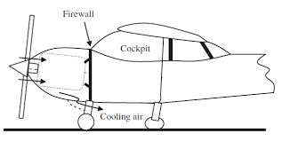
Firewall
In automotive engineering, the firewall separates the engine compartment from the passenger compartment (driver and passengers).
The name originates from steam-powered vehicles, where the firewall separated the driver from the fire heating the boiler.
Firewall
Wing

Slide 6
Firewall
In computer networking, a firewall is hardware or software or combination of both designed to prevent unauthorized access to or from a private network
The firewall examines all messages entering or leaving the internal network and blocks those that do not meet specified security criteria
It is placed at the junction point or gateway between the two networks, which is usually a private network and a public network such as the internet
To be effective, the firewall must be the only interconnection device between the networks
BUT – this creates a single point of failure!

Slide 7
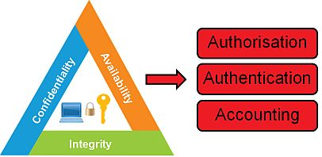
AAA
Firewalls provide a single block point, where security and auditing can be imposed.
Firewalls provide an important logging and auditing function, providing summaries to the Administrator about what type/volume of traffic has been processed through it.
This is an important benefit: Providing this block point can serve the same purpose on the network as an armed guard does for physical premises.
BUT – this creates a single point of failure!

Slide 9
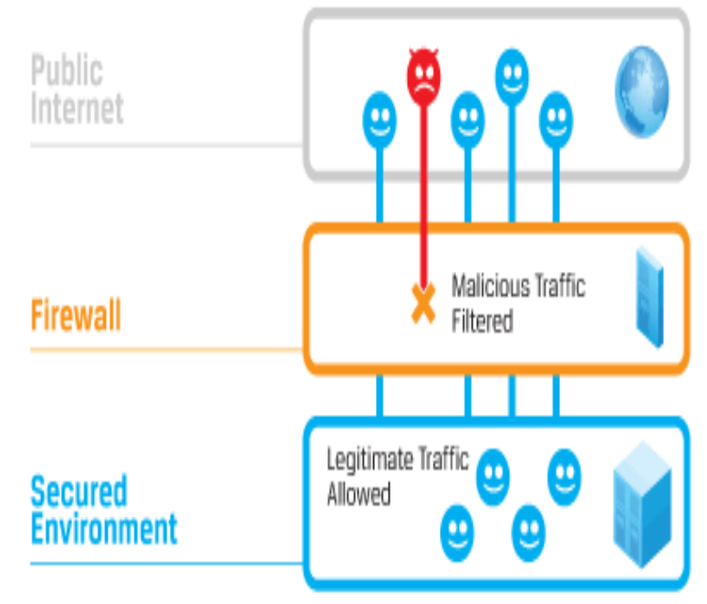
Types of Firewalls
Network layer firewalls (Packet Filters)
Make their decisions based on the source address, destination address and ports in individual IP packets.
A simple router is the traditional network layer firewall: not able to make particularly complicated decisions about what a packet is actually talking to or where it actually came from.

Slide 10
Types of Firewalls
“Stateful” firewall
A capability of a packet filtering firewall
Keep track of TCP sessions that are currently active
More properly refers to filtering rules rather than the firewall itself
Only TCP maintains state (3-way handshake)
IP, UDP, ICMP are stateless (every packet is independent)

Slide 11
Types of Firewall
Host-based firewalls (Packet Filters)
Runs on an endpoint system rather than on a gateway or router that links two networks
Allows you to define rules that allow or disallow specific executables to run and communicate across the network.
Good example: Windows Firewall -> Advanced Security settings

Slide 12
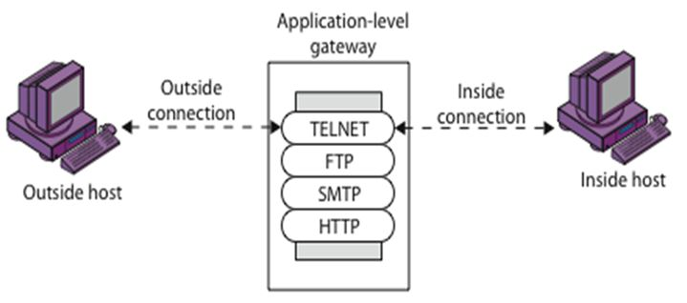
Types of Firewalls
Proxy (application layer) firewalls
proxy servers do not permit traffic directly between networks.
They can examine traffic and perform elaborate logging.
They can also be used for Network Address Translation (NAT, which uses port forwarding), to hide the origin of a connection.

Slide 13

Types of Firewalls
Layer 7 firewalls
Also called
application layer gateways
deep packet inspection
next generation firewalls
These watch traffic at the packet level but examine the data within each one. They are able to decode that information and determine exactly what application is generating those data frames.
e.g., SQL Server, Twitter, Facebook, etc.

Slide 15
Access Control Lists (ACLs)
Access Control Lists (ACLs) can be set up on routers and servers to accept or deny packets from particular addresses or services.
Security policy: packet filter will either
Deny specific types of packets and accept all else
requires a thorough understanding of specific security threats
can be hard to implement
Accept specific types of packets and deny all else
does not have to predict future attacks
requires a good understanding of network requirements

Slide 16
ACL
Firewall rule lists are usually examined from the top of the list, down through to the bottom.
Firewall will look at the first rule, see if anything matches in that particular rule. If it doesn’t, it goes to the next rule and see if that rule matches the traffic, and so on.
On most firewalls, at the bottom of the list is an “implicit deny”. This means that if the traffic coming through the firewall doesn’t match any of the rules above, it is dropped by the firewall.

Slide 17
DMZ
Internet Service Provider
Enterprise
Network
ACLs on router and individual servers
Web, File, DNS, Mail Servers
DMZ: demilitarized zone
(uncontrolled access)
Internet Service Provider
Enterprise
Network
“Militarized”: Every access is examined and logged
ACLs on dedicated firewall or “Bastion Host”
Web, File, DNS, Mail Servers
Notes:
17

Slide 19

IDS: Intrusion Detection System
Gathers and analyzes information from within a computer or a network to identify the possible violations of security policy, including unauthorized access and misuse
The ultimate aim is to catch perpetrators before they do real damage to your resources
Based on your security policy and administrator intuition and experience
Uses:
Rogue system detection.
Reconnaissance identification.
Attack pattern identification.

Slide 20
Types of IDS
Network-Based Intrusion Detection
Listening for patterns indicative of an intrusion
Log File Monitoring
Programs that parse log files after an event has already occurred, eg. Failed log in attempts
File Integrity Checking
Check files been modified indicating an intruder has already been there

Slide 21





IDS vs. Firewall
Firewall directly allows or denies access to services based on network and transport layer header information in individual packets such as address, service, and direction of the packet.
Network IDS analyses sets of packets (traffic patterns) to determine misuse (malicious or abusive activity inside the network) or intrusion (from the outside).
When something suspicious has been identified it signals an alarm
Possible SYN flood!

Slide 22
ACLs on router and individual servers
DMZ: demilitarized zone
(uncontrolled access)
DMZ
Internet Service Provider
Enterprise
Network
Web, File, DNS, Mail Servers
IDS Inside:
Catches what was missed by the Firewall
IDS Outside:
Catches everything the world throws at you – Good for research
Notes:
22

Slide 23
False Positives are an issue with IDS
False Positive
Something incorrectly identified as a vulnerability.
Normal activity identified as malicious
Annoying, but no security breach
Impact is Opposite of Biometric Systems!
False Negative
Impact is Opposite of Biometric Systems!
Something incorrectly identified as secure.
Malicious activity identified as normal
Security Breach – Mission Failure!

Slide 24

Intrusion Prevention System (IPS)
A system that performs the functions of an IDS but that can also take action (like a firewall) to block threats.
Configure the threats that should be handled automatically.
Passive response still implemented for other incidents.
Useful, but with some pitfalls:
False positives may lead to the blocking of legitimate behavior.
False negatives may lull you into a false sense of security.
A well-managed and finely tuned IPS is a powerful defense option.
Possible SYN flood!
Traffic dropped!

Slide 25


Unified Threat Management
A system that centralizes various security techniques into a single appliance.
Usually include a single console from which to administrate defenses.
Created in response to cost and complexity issues of discrete systems.
Can streamline security process and make management of defenses easier.
Downsides:
Creates a single point of failure in the network.
Can struggle with network latency issues.
VPN

Slide 26
Packet Filtering: iptables
Configure tables of packet-filter rules in Linux kernel
Each table has a number of chains
Each chain consists of a list of rules
Each rule specifies what to do with a matching packet
The default table (filter) has 3 built-in chains:
INPUT controls traffic from outside the LAN
OUTPUT places restrictions on outbound connections
FORWARD allows control over routing between interfaces

Slide 27
iptables - rules
IPTables uses policies (-P) to create default rules
The following rules will block all traffic on a network gateway,
iptables -P INPUT DENY
iptables -P OUTPUT REJECT
iptables -P FORWARD REJECT
DROP and DENY silently drop packets, REJECT returns a connection refused error to users
Specific rules are appended (-A) at the end of an existing ruleset.
-A is followed by the name of the chain for a rule. then Flags like
(p)rotocol
(i)nterface
(s)ource (d)estination (sport) (dport)

Slide 28
iptables – Rule examples
# refuse telnet connections
iptables -A INPUT -p tcp --sport telnet -j REJECT
iptables -A INPUT -p udp --sport telnet -j REJECT
# allow ssh connections
iptables -A INPUT -p tcp --sport 22 -j ACCEPT
iptables -A INPUT -p udp --sport 22 -j ACCEPT
# Allow new TCP connections from hosts in the
# 192.168.1.0/24 network to port 137 (stateful)
iptables -A INPUT -m state --state NEW -m tcp -p tcp
-s 192.168.1.0/24 --dport 137 -j ACCEPT
Rules must be defined in a script that runs at boot time

Slide 29
Actual rules
# Allow new TCP connections from hosts in the 192.168.1.0/24 network to port 137 (stateful)
iptables -A INPUT -m state --state NEW -m tcp -p tcp -s 192.168.1.0/24 --dport 137 -j ACCEPT
# Once an approved connection is up, go no further than this rule
iptables -A INPUT -m state --state RELATED,ESTABLISHED -j ACCEPT

Slide 30
Actual rules
--state
A comma separated list of the connection states to match.
Possible states are:
NEW the packet has started a new connection, or otherwise associated with a connection which has not seen packets in both directions
ESTABLISHED the packet is associated with a connection which has seen packets in both directions
RELATED the packet is starting a new connection that is associated with an existing connection, such as an FTP data transfer or an ICMP error

Slide 31
NSF Shares: Protecting Portmap
Also add iptables rules to the server restricting access to specific networks.
This example allows connections to the portmap service (listening on port 111) from the 192.168.0/24 network and from localhost - All other packets are dropped.
iptables -A INPUT -p tcp -s! 192.168.0.0/24 --dport 111 -j DROP
iptables -A INPUT -p udp -s! 192.168.0.0/24 --dport 111 -j DROP
iptables -A INPUT -p tcp -s 127.0.0.1 --dport 111 -j ACCEPT
iptables -A INPUT -p udp -s 127.0.0.1 --dport 111 -j ACCEPT

Slide 33
TCP Wrapper
In general terms, a TCP wrapped service is one that has been compiled with the libwrap library
These typically include sshd, sendmail, xinetd, etc.
When a connection attempt is made the service checks if connection is allowed based on rules in /etc/hosts.allow and /etc/hosts.deny
If no rules for the service are found in either file, or if neither file exists, access to the service is granted.
Changes to the hosts.allow and hosts.deny are dynamic: they take effect as soon as the file is saved.

Slide 34
TCP Wrapper - Examples
ALL : .example.com EXCEPT cracker.example.com
If this rule appears in /etc/hosts.allow, all example.com hosts are allowed to connect to all services except cracker.example.com
If this rule appears in /etc/hosts.deny, only cracker.example.com has access to all services, and other example.com hosts have access to none
So, what is the effect of this?
ALL EXCEPT telnetd : 192.168.0.
Only specifically allowed
Only specifically denied
hosts.deny can simply specify
ALL:ALL
With all specific rules in hosts.allow
blocked unless explicitly allowed is also called Implicit deny

Slide 35
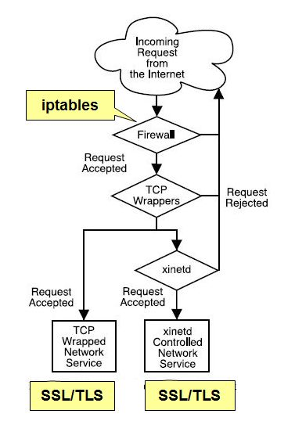
IPtables or TCPwrap ?
TCPwrap is simpler, rules take effect immediately, can use domain names
IPtables is faster, but rules are more difficult to write and require restart, limited to layers 3 and 4
No need for redundant rules
Lots of ways to divide things up
Need to use the logfiles over time to see traffic patterns and make informed decisions

Slide 37
hping
hping is a packet assembler/analyzer used for crafting TCP/IP packets.
It sends empty (0 data byte) packets by default, but has lots of options for tuning the payload
You can experiment probing and analysing your firewalls and network by sending a variety of probe types with different flag settings.

Slide 38
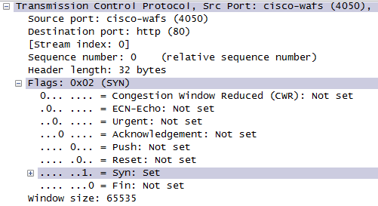
Background: TCP
The TCP segment (packet) header has six flag bits that can be set independently.
A mnemonic to remember them in order is
Unskilled Attackers Pester Real Security Folks.
http://www.lovemytool.com/blog/2010/07/practical-tcp-series-tcp-flags-by-chris-greer.html

Slide 39
Background: TCP
Four flag bits can be set to describe the state of the connection:
SYN (SYNchronise) is used for starting a connection
ACK (ACKnowledge) is used to confirm packets are received
FIN (FINish) is used for ending a connection
RST (ReSeT) is used to denote no service on the port (closed)
PSH (PuSH) and URG (URGent) are used to ensure priority over other packets for processing when a packet is received.
The CWR and ECN bits may be used together by a client and server that can use RFC 3168 Explicit Congestion Notification.

Slide 40
Background: TCP
The initial connection with a TCP service is established with the "TCP 3 way handshake".
First a SYN is sent to a port that has a service bound to it (an open port). Typical examples are HTTP (port 80), SMTP (port 25), or SSH (port 22).
The server side will see the SYN and respond with SYN + ACK, with the client answering with an ACK. This completes the set up and the data of the service protocol can now be communicated.
After this, an ACK is sent after receiving each "window size" group of packets (details are beyond our scope, we have nice graphic).
When a host sends a FIN to close a connection, it may continue to receive data until the remote host has also closed the connection, although this only occurs under certain circumstances.

Slide 41
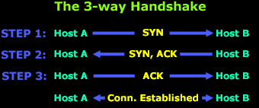
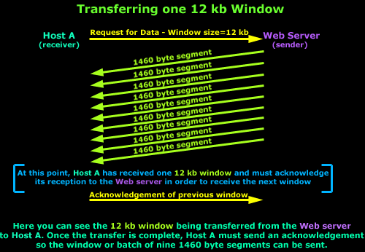
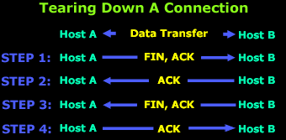
Background: TCP
http://www.firewall.cx/networking-topics/protocols/tcp/136-tcp-flag-options.html
http://www.firewall.cx/networking-topics/protocols/tcp/137-tcp-window-size-checksum.html

Slide 42
Testing Rules
Verifying that your firewall rules are performing as intended should be a regular procedure.
Once you have identified any unfiltered ports or other issues, you should review your firewall rules to ensure that access to all services is controlled, and that filters and rules are performing as intended.
After changes are implemented, run the audit scan again to ensure that your changes achieve the desired effect.
See this article about checking the status of your firewall rules
https://www.cyberciti.biz/tips/linux-iptables-examples.html
Note that there are a few tips that are RHEL / Fedora / CentOS Linux specific, but all of the IPTables rules themselves are valid for any distro.

Slide 43
References
Red Hat Linux Security Guide
Chapter 2. Attackers and Vulnerabilities
Appendix A. Common Exploits and Attacks
5.1. Securing Services With TCP Wrappers and xinetd
5.2. Securing Portmap
5.4. Securing NFS
5.5. Securing Apache HTTP Server
7.1.1. IPTables Overview
Red Hat Linux Reference Guide
Chapter 15. TCP Wrappers and xinetd
Chapter 16. iptables

